Slide 1
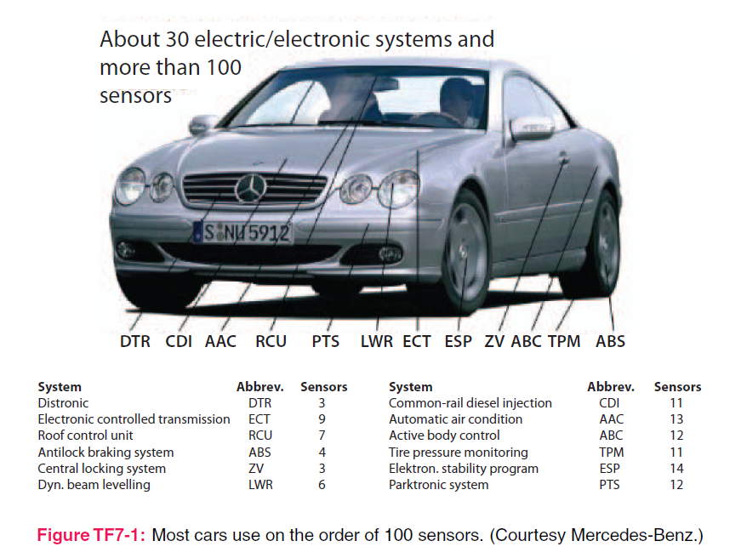
4. Electrostatics
7e Applied EM by Ulaby and Ravaioli

Slide 2
Chapter 4 Overview

Slide 3
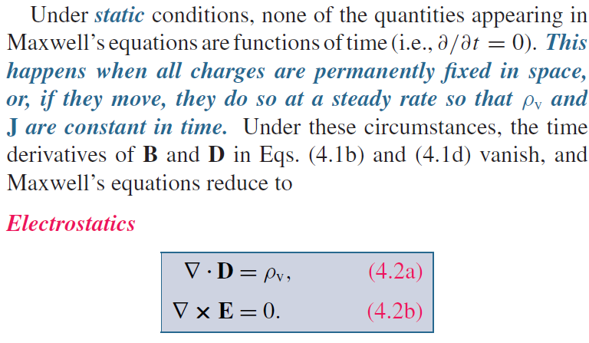
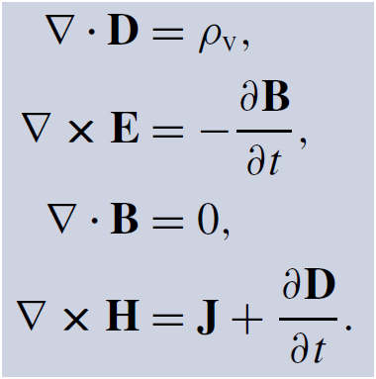
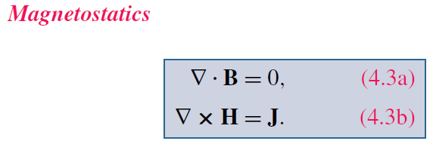
Maxwell’s Equations
God said:
Charge density
Current density
And there was light!

Slide 4
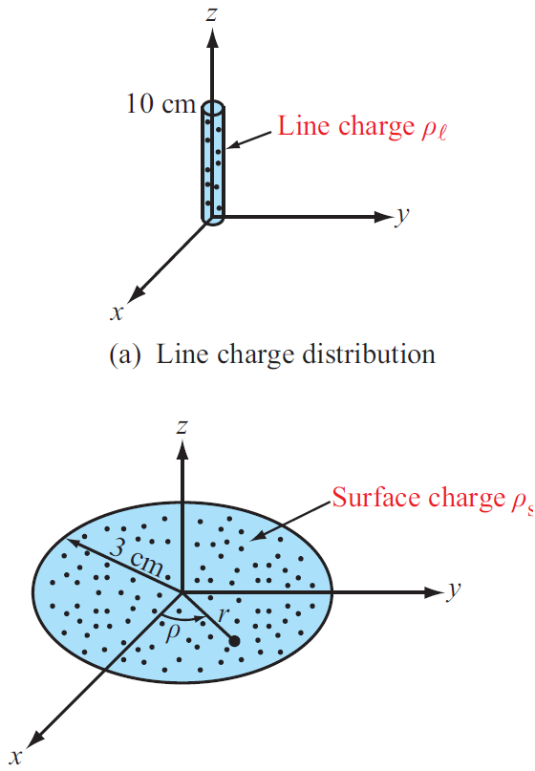
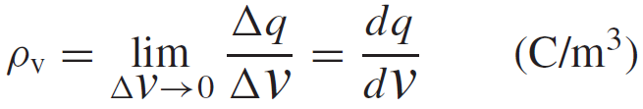
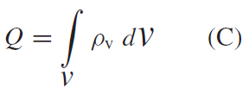
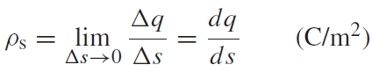
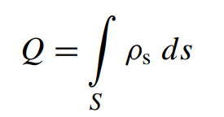
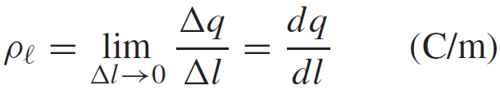
Charge Distributions
IDEA: from discrete to continuous distribution. Charge density is a statistic concept at a scale much greater than the atomic scale.
Volume charge density:
A function of (x, y, z, t) in general, hence the concept of “distribution”
Total Charge in a Volume
Surface and Line Charge Densities
Which to use depends on physical problems, but be careful about the UNIT !

Slide 5
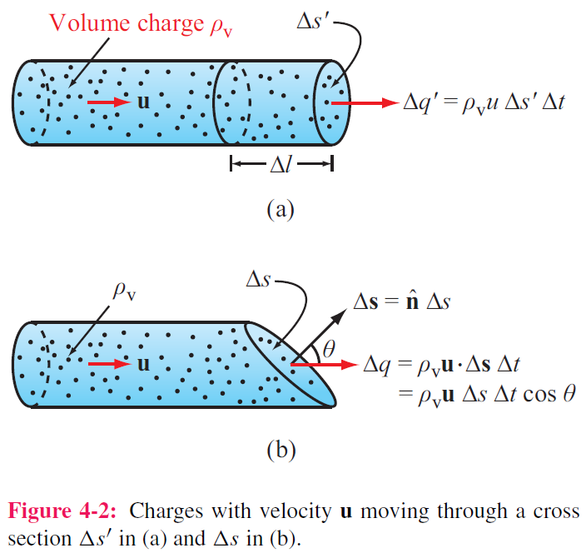
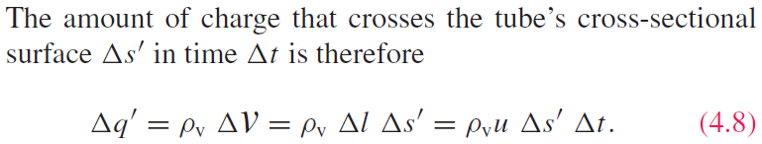
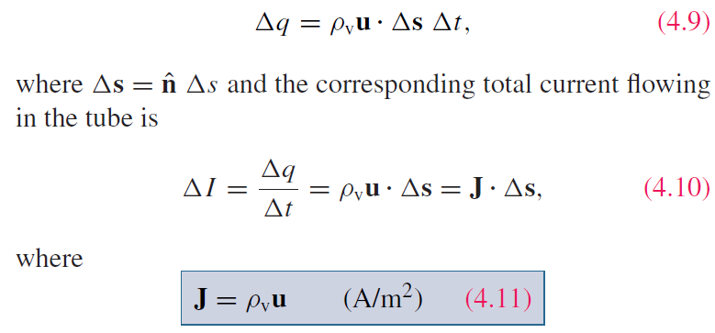
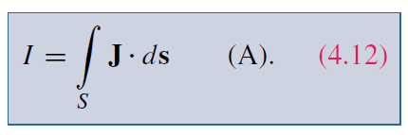
Current Density
a tube with volume charge density ρ_{v}, velocity of u alogn axis
uΔt
For a surface with any orientation:
(Consider the projection of u along surface normal)
J is called the current density
Volume current density
Charge velocity
Surface current density

Slide 6
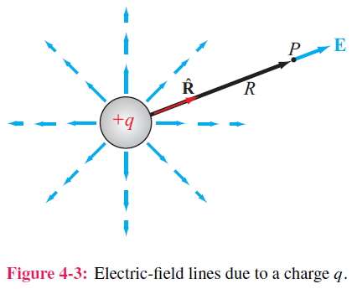
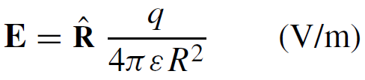
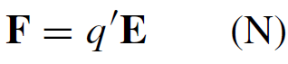
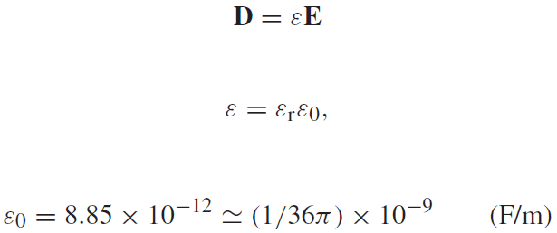
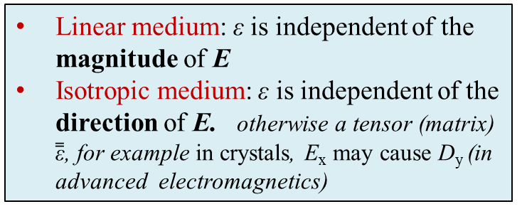
Coulomb’s Law
Electric field at point P due to an isolated charge
How to determine the direction of E ？
Electric force on a test charge q’ placed at P
Linear medium: ε is independent of the magnitude of E
Isotropic medium: ε is independent of the direction of E. otherwise a tensor (matrix) $\overset{̿}{\text{ε}}$, for example in crystals, E_{x} may cause D_{y} (in advanced electromagnetics)
So E has a unit of N/C = V/m ？ (Ch4-5)
Electric flux density D in material of electric permittivity ε

Slide 7
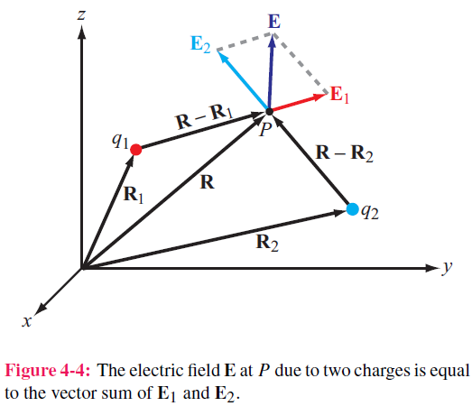
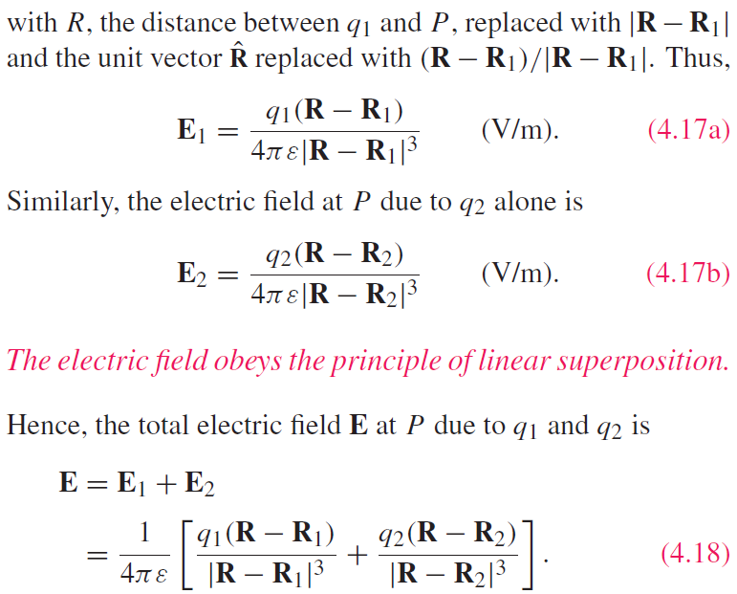
Electric Field Due to 2 Charges
Electric field at point P due to TWO charges
Basic Idea: linear superposition (vector summation)

Slide 8
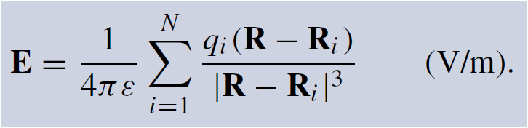
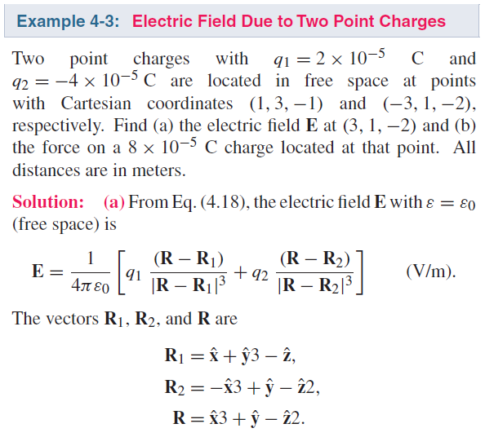
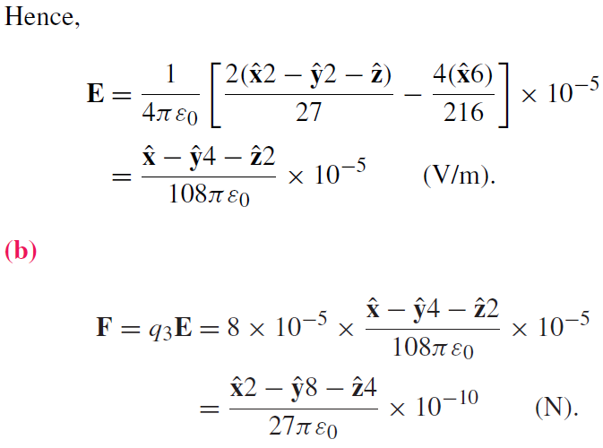
Electric Field due to Multiple Charges

Slide 9
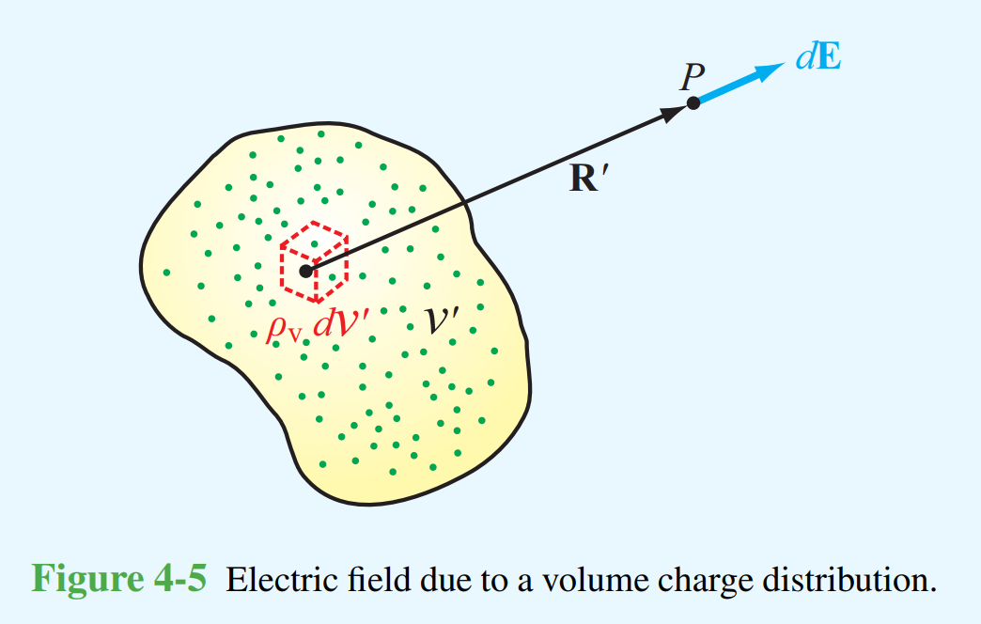
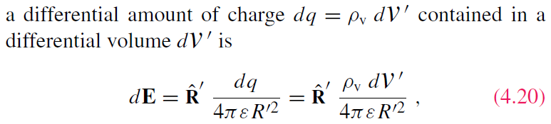
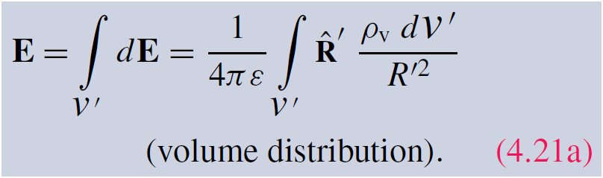
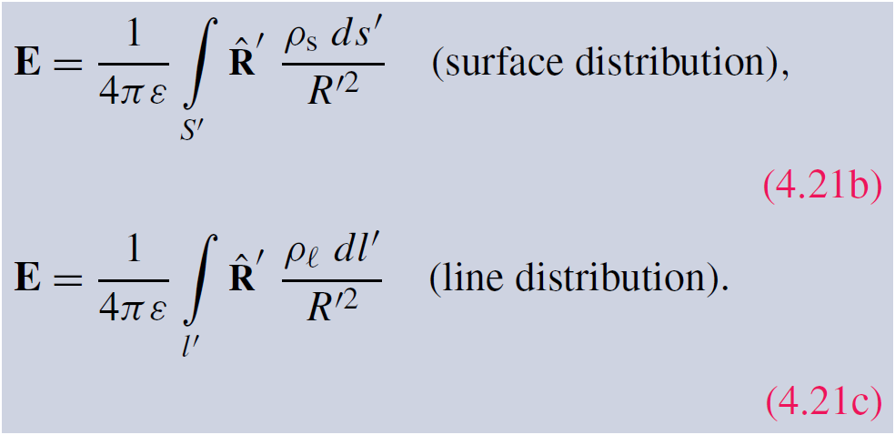
Electric Field Due to Charge Distributions
To extend the results obtained for the field due to discrete point charges to continuous charge distributions
Field due to:
Note: the distance vector R’ is pointing to the observation point from the source point, not necessarily from the origin of the coordinates.

Slide 10
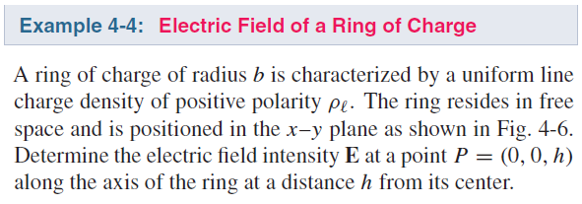
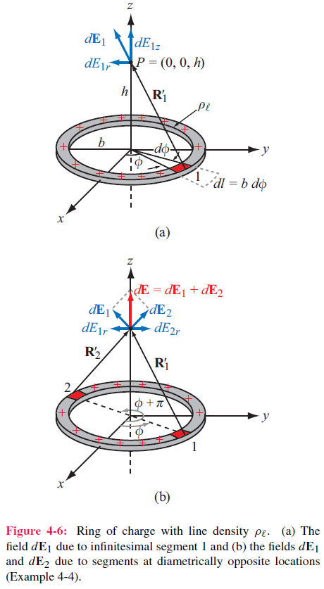
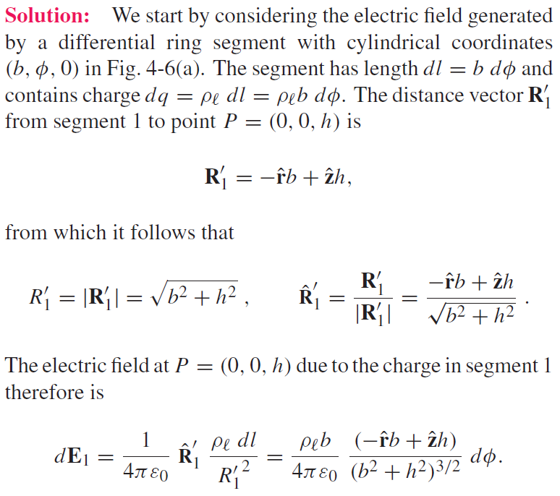
Cont.

Slide 11
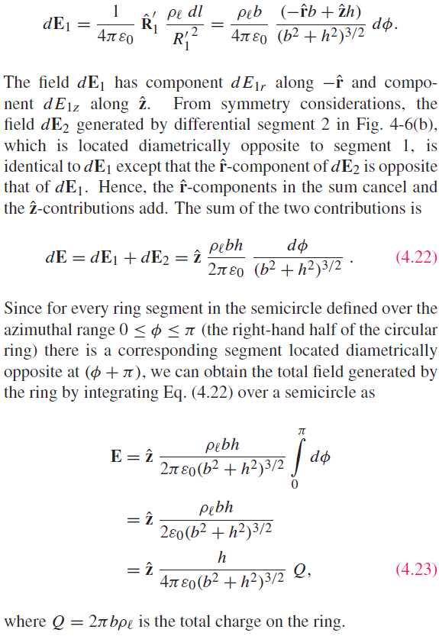

Slide 12
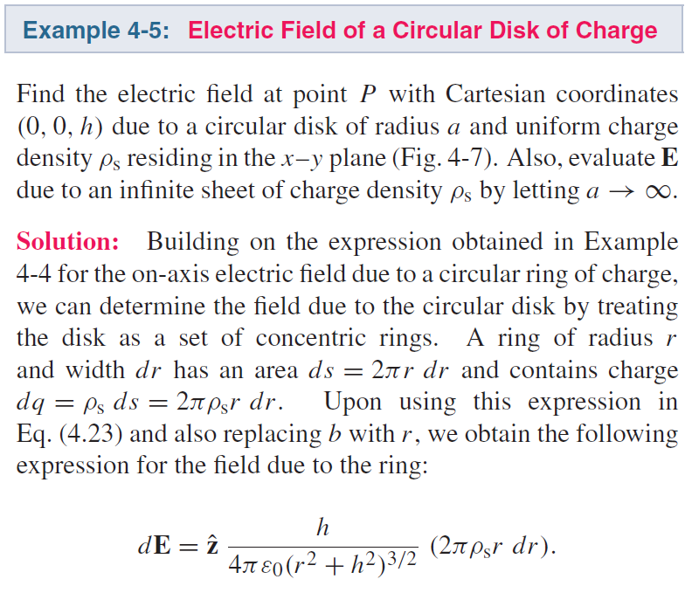
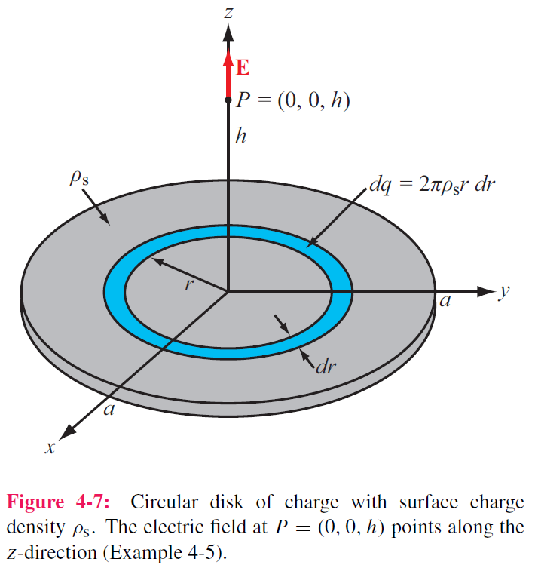
Cont.

Slide 13
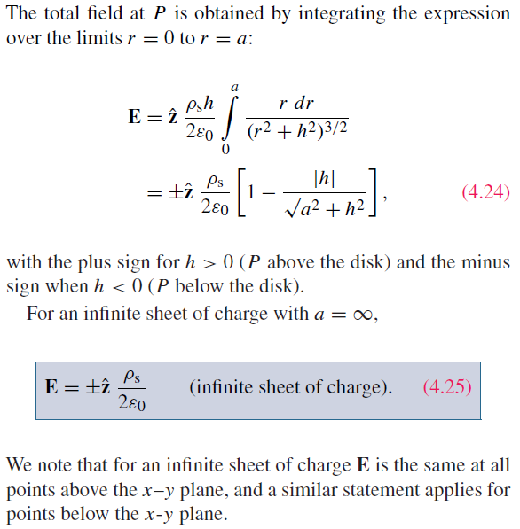

Slide 14
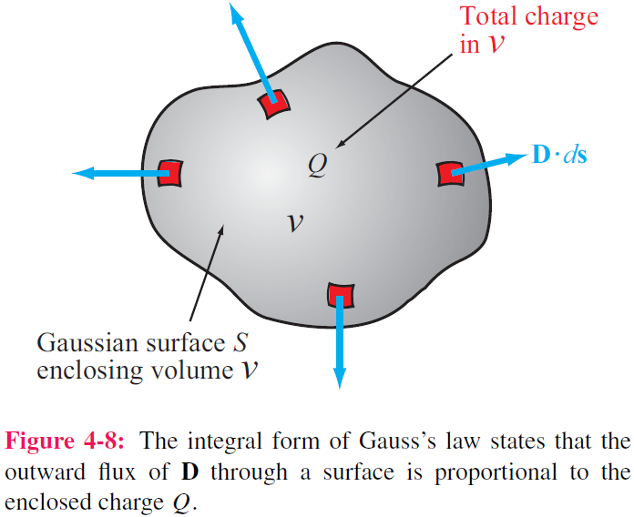
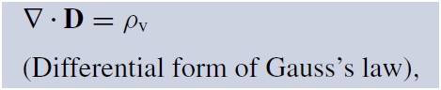
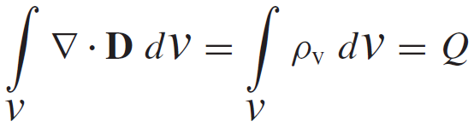
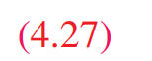
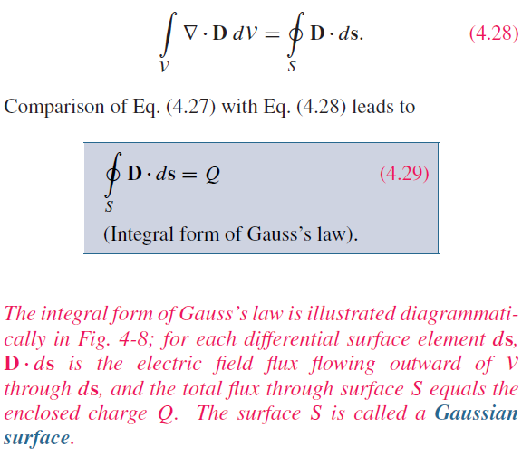
Gauss’s Law
Application of the divergence theorem gives:

Slide 15
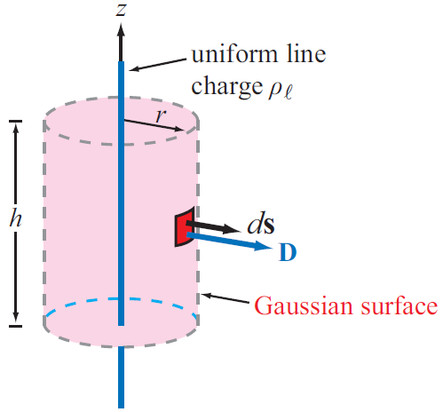
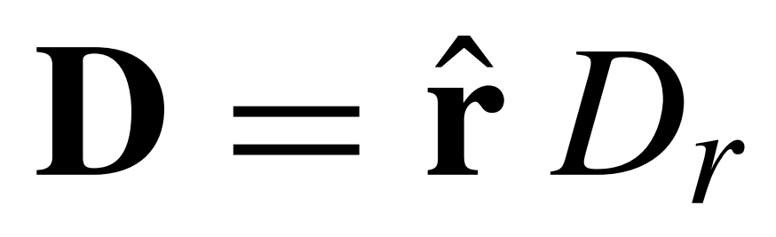
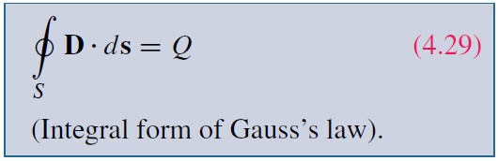
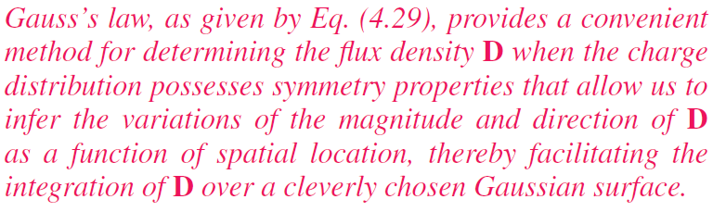
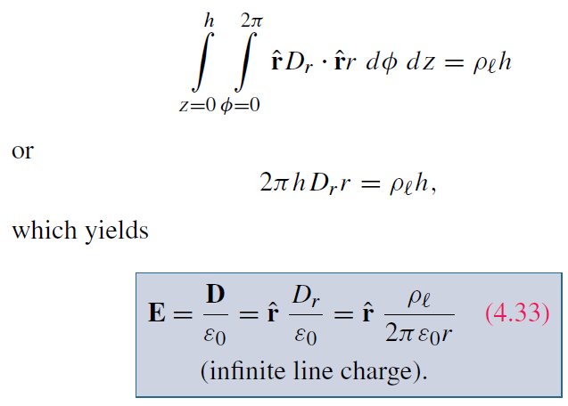
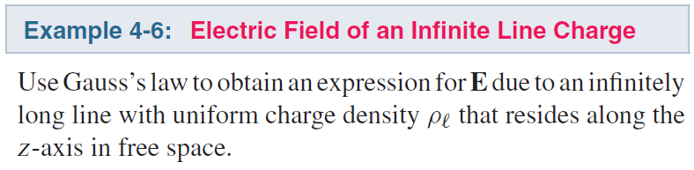
Applying Gauss’s Law
– E-field of infinite line of uniform charge
Construct an imaginary Gaussian surface in cylinder shape, with radius r and height h， and concentric around the line of charge
Total Charge is
D is constant and normal or tangential to the subsurface，see example 4-6
Try to Calculate div E

Slide 16
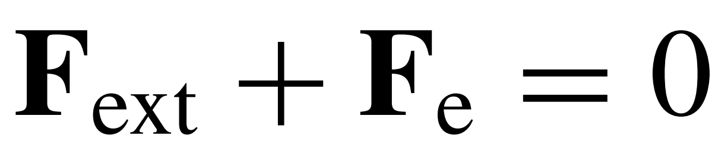
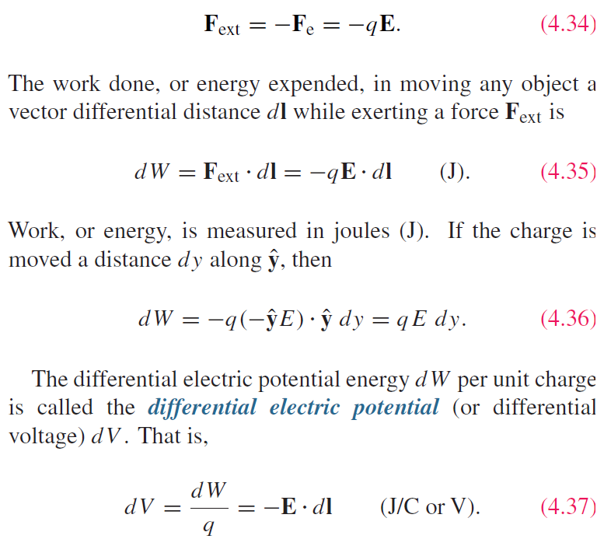
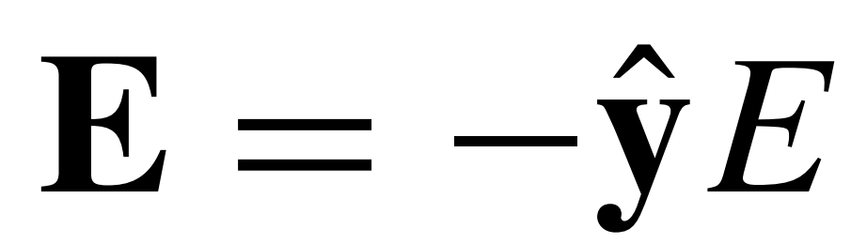
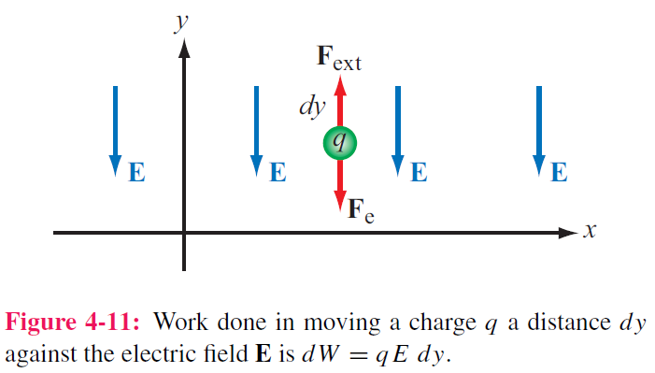


Electric Scalar Potential
The termd “voltage” is short for “voltage potential” and synonymous with electric potential.
Constant speed of +q requires
External force
The voltage difference V between two points in a circuit represents the amount of work (or potential energy) required to move a unit charge from one to the other.
Work
Consider +q in a uniform
F_{ext} to counteract F_{e}
dl → d$\hat{y}$

Slide 17







Electric Scalar Potential
The potential difference corresponding to moving a point charge from point P₁ to point P₂ is obtained by integrating Eq. (4.37) along any path between them
independent of the integration path from P₁ to P₂
V₁ and V₂ are the electric potentials at points P₁ and P₂
$∇×E=∂B$/$∂t=0$ → irrotational
Kirchhoff's voltage law

Slide 18





Electric Potential Due to Charges
For a point charge at origin, V at range R is
(for charge at elsewhere)
The principle of superposition also applies for the potential due to N discrete point charges
In electric circuits, we usually select a convenient node that we call ground and assign it a zero reference voltage. In free space and material media, we choose infinity as reference with V = 0. Hence, at a point P
For continuous charge distributions:

Slide 19


Relating E to V
Inversely, to find E due to V, reexamine
Be careful about the sign！
Potential before field, simpler

Slide 20


Two far-distance approximations
numerator
Cont.

Slide 21



(cont.)
The numerator
p: length vector scaled by charge
Without the approximations
(Exact E anywhere)
(4.51)
when R>>d only

Slide 22


Poisson’s & Laplace’s Equations
In the absence of charges:

Slide 23


Conduction Current
Constitutive Parameters
Electric permittivity ε
Magnetic permeability μ
Conductivity σ
Description
The conductivity of a material is a measure of how easily electrons can travel through the material under the influence of an externally applied electric field.
Conduction current density:
Conduction current density:
Conductivity
Perfect dielectric σ = 0
Perfect conductor σ =∞ (superconductor)
Good conductor σ: >10⁶ (most metals)
Good insulator σ：10⁻¹⁰ ~ 10⁻¹⁷
Semiconductor σ：in between
Note how wide the range is, over 24 orders of magnitude

Slide 24


Conductivity
Definition
ρ_{ve} = volume charge density of electrons
ρ_{vh} = volume charge density of holes
μ_{e} = electron mobility
μ_{h} = hole mobility
N_{e} = number of electrons per unit volume
N_{h} = number of holes per unit volume
Internal only
Good conductors are internally treated with E_{inside} = 0

Slide 25




Resistance
The linear resistor is connected to a dc voltage source V .
Expression for resistance R of a conductor of length l and uniform cross section A
$\overset{⃑}{E}$= $\hat{x}$E_{x} due to V between points x₁ and x₂
Generalized to arbitrary resistor
Ohm’s law
Conductance for:
unit of Ω⁻¹ or siemens (S)

Slide 26



Example: conductance of Coaxial Cable
Basic idea: determine direction of E first (r) in order to relate J to E by Ohm’s Law. So to find J along r. Next to relate J, E to potential V.
note: we often set auxiliary yet fundamental quantities which eventually disappear
G’=0 if the insulating material is vacuum or a perfect dielectric with zero conductivity.

Slide 27




Joule’s Law
For a conducting medium of volume V, the power dissipated in the presence of electric field E is:
Consider Ohm’s Law,
For a resistor, Joule’s law reduces to:
(see 4.82)
For a coaxial cable:

Slide 28


Dielectric Materials
In a dielectric, electrons are strongly bound to the atom, hence difficult to migrate freely.
nonpolar
molecule
polarization
E-field
polarized
molecule
dipole
representation

Slide 29

Electric Breakdown
Beyond E_{ds}, electrons will detach from the molecules and accelerate through the material in the form of a conduction current. (Sparkling)

Slide 30

Boundary Conditions
Boundary conditions specify how the components of fields (tangential and normal to an interface between two media) relate across the interface.
It limits the solutions to Maxwell’s Equations by giving certain constraints (across the interface of two media)
The boundary conditions are facts, which are only dependent on the constitutive parameters of the media. (independent of external field or time variance)

Slide 31





Boundary Conditions
B.C. for tangential components
Let$∆h→0$
Conservative property of the electric field
Tangential electric field is continuous across the interface

Slide 32







Boundary Conditions
B.C. for normal components
Total outward flux of D equals to charge enclosed
Let$∆h→0$
Normal electric flux density jumps by an amount of surface charge density

Slide 33

What about Volume Charge Density
What about if volume charge density exist across the interface as shown below
Interface
Volume charge distribution with ρ_{v}
So volume charge distribution does not induce discontinuity of D

Slide 34





Slide 35

Summary of Boundary Conditions
Remember E = 0 in a good conductor

Slide 36



Conductors
Net electric field inside a conductor is zero
Obtained from Gauss’ law or boundary condition
dielectric
Infinitely long
dielectric
Upper slab surface
Lower slab surface
Inside
conductor
Total E=0
E_{i}=-E₁

Slide 37



Field Lines at Conductor Boundary
At conductor boundary, E field direction is always perpendicular to conductor surface （to satisfy B.C.）

Slide 40





Capacitance
Two conducting bodies separated by an insulating (dielectric) medium, form a capacitor.
S is the +Q surface and P1 is on S.

Slide 41


Capacitance
For any two-conductor configuration:
Generalized form
For any resistor: (note the sign or make it positive)

Slide 42



If the plate dimensions are much larger than the separation d (quasi-uniform field)
Ignored fringing field
Therefore, larger d for larger V_{br}.

Slide 43



Application of Gauss’s law gives:
Q is total charge on the inner surface of the outer cylinder.
–Q is on the outer surface of inner cylinder

Slide 44







Electrostatic Potential Energy
When charging up a capacitor, the energy will be stored in the dielectric medium as electrostatic potential energy We, related to Q, C, and V .
Using C = Q/V ,
Energy stored in a capacitor
Since C = εA/d for parallel-plate capacitor
Work dW_{e} required to transfer an additional incremental charge dq from one conductor to the other is
Electrostatic potential energy density
In total,
Total electrostatic energy stored in a volume

Slide 45

Image Method (Image Theory)
Only valid for the region above conductor
Image method simplifies calculation for E and V due to charges near conducting planes.
For each charge Q, add an image charge –Q
Remove conducting plane
Calculate field due to all charges

Slide 46




Slide 47



